Slide 1


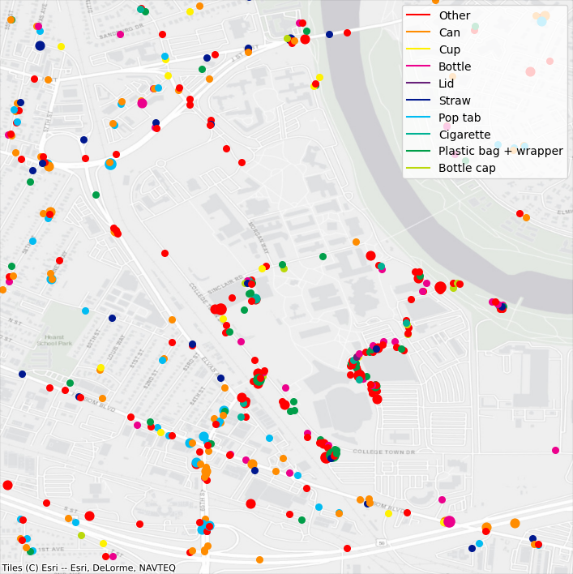
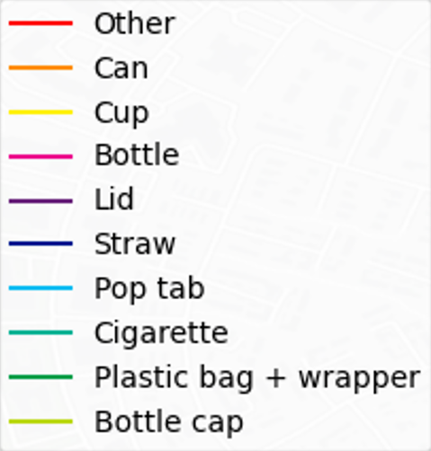
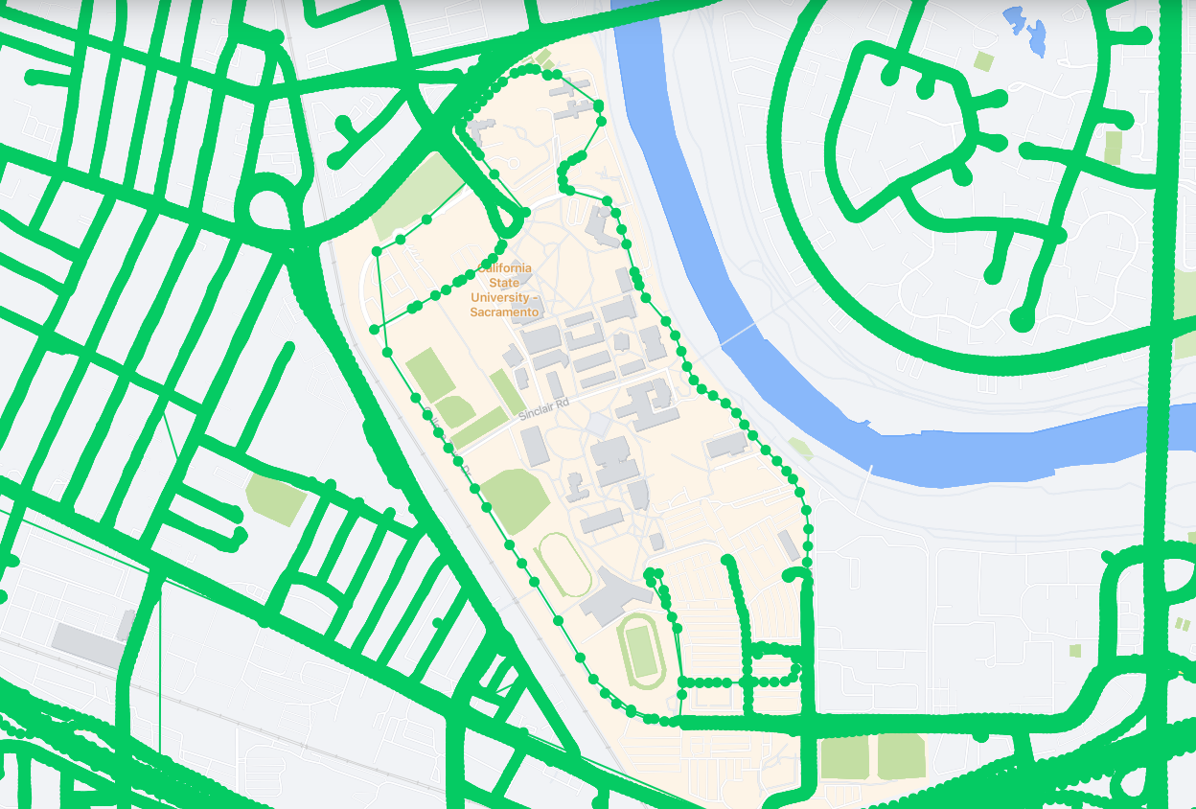
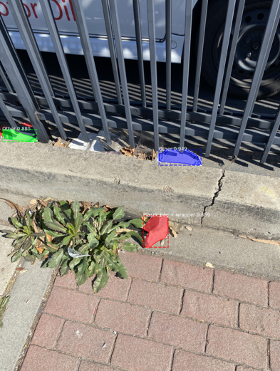
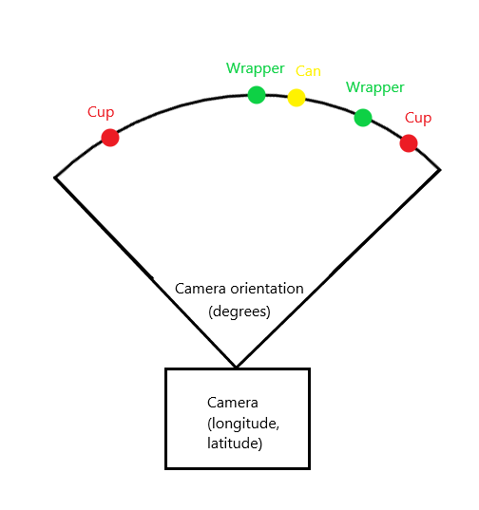

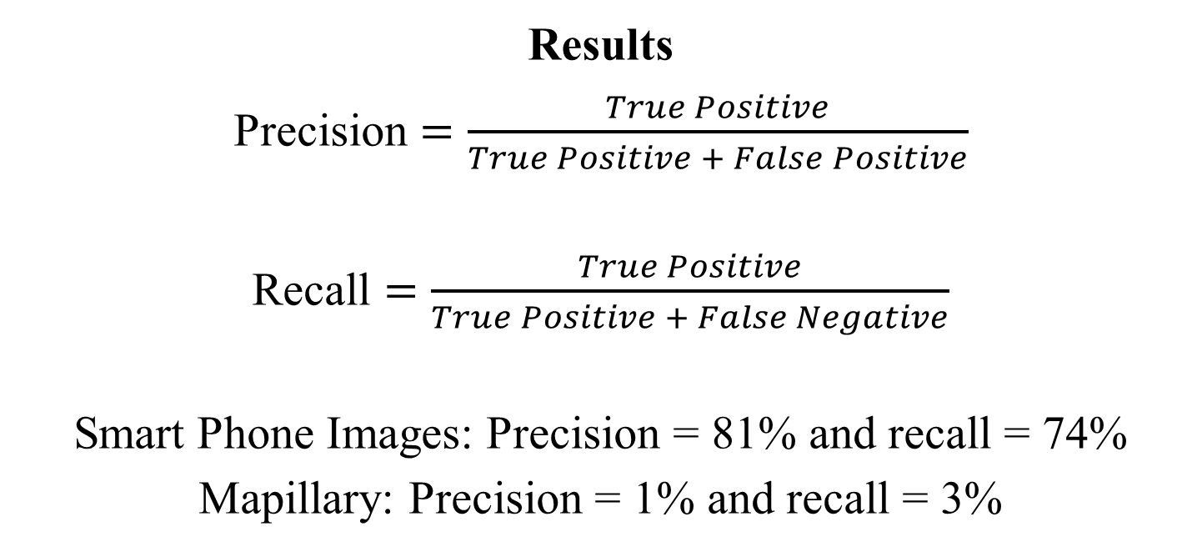
Searching for Uncollected Litter with Computer Vision
Julian Hernandez
Faculty Mentor: Dr. Fitzgerald
California State University, Sacramento
Abstract
This study combines photo metadata and computer vision to quantify where uncollected litter is present. Images from the Trash Annotations in Context (TACO) dataset were used to teach an algorithm to detect 10 categories of garbage. Although it worked well with smartphone photos, it struggled when trying to process images from vehicle mounted cameras. However, increasing the variety of perspectives and backgrounds in the dataset will help it improve in unfamiliar situations. These data are plotted onto a map which, as accuracy improves, could be used for measuring waste management strategies and quantifying trends.
Problem
Trash production is doubling every decade
Only 10% of plastic is recycled
270 species are harmed or killed by waste pollution
Globally costs over $200 billion a year
Waste produces 5% of global GHG emissions
80% of marine waste originates on land
Research Question
Can computer vision help identify new areas that need to be cleanup and measure how much waste is removed?
Methods
Algorithm: Masked Regional Convolutional Neural Network
Training dataset: Trash Annotations in Context
Detection datasets: Mapillary and hand collected images
Future Work
Collect new images of trash, and add them to the TACO database to increase accuracy and help the algorithm reject cars
Build a smart trash can that can see what trash is about to be thrown away and alert the person which is the correct bin
Results
Precision $=\frac{True Positive}{True Positive + False Positive}$
Recall $=\frac{True Positive}{True Positive + False Negative}$
Smart Phone Images: Precision = 81% and recall = 74%
Mapillary: Precision = 1% and recall = 3%
Challenges
Low quality images increase noise
Solution: Minimum 1080p
Overfit algorithm
Solution: Collect a diverse set of images
New backgrounds causing lots of false positives
Solution: Add a new category ‘not trash’ with pictures of cars
Conclusion
For car mounted camera detection many more images are needed
Detection works on smart phone images and can be used in clean up strategies today
References available upon request from julianhernandez@csus.edu

